Slide 1


ARTIFICIAL INTELLIGENCE
Mini Project
Guided by: Prof.(Dr.) Nirali Nanavati

Slide 2

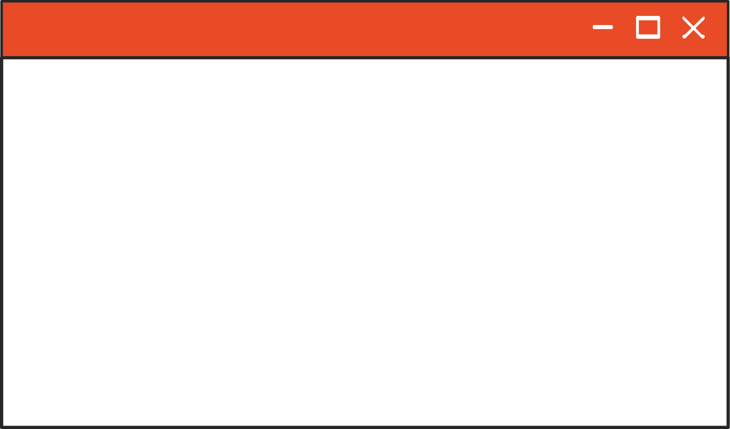

AUTOMATED ATTENDANCE SYSTEM
A face-detection based attendance tracker
Why is your attendance low Ayush?
ok

Slide 3

PURPOSE
Our main focus behind this project was to come up with a solution which helps to automize the attendance marking process in our college classes
This will help the students to swiftly mark their attendance and largely decrease the work load of faculty members.

Slide 4


LIBRARIES
Python Library used in the project:
cv2
face_recognition
numpy
pickle
openpyxl
datetime
os

Slide 5
WORKING
First off we used the CV2 library in python to use our laptop camera for live feed.
By pressing the spacebar user can capture an image from the live camera feed which is then used further in the model.
Then using the face recognition library we identified the faces in the captured image frame from the camera feed by converting it into encodings
Once the encoding of the frame is done we then compare it with our
pre-saved encoding database

Slide 6
ENCODING
We have made encodings for some of the students using their images.
This encodings are then saved in a pickle file (better than JSON in terms of accessibility)
The encodings are saved with a class name which is the same as that of the image file name. (student name)
In the attendance model, we traverse this database/pickle file so as to find a match for the encoding of our current captured frame.

Slide 7
SAVING IN EXCEL
Once a match is found we display the name of student with whom the capture frame matches the best.
Now that the students is identified, we take the name of student and the time at which the image was captured.
This data is then saved to an Excel Sheet using openpyxl library.

Slide 8
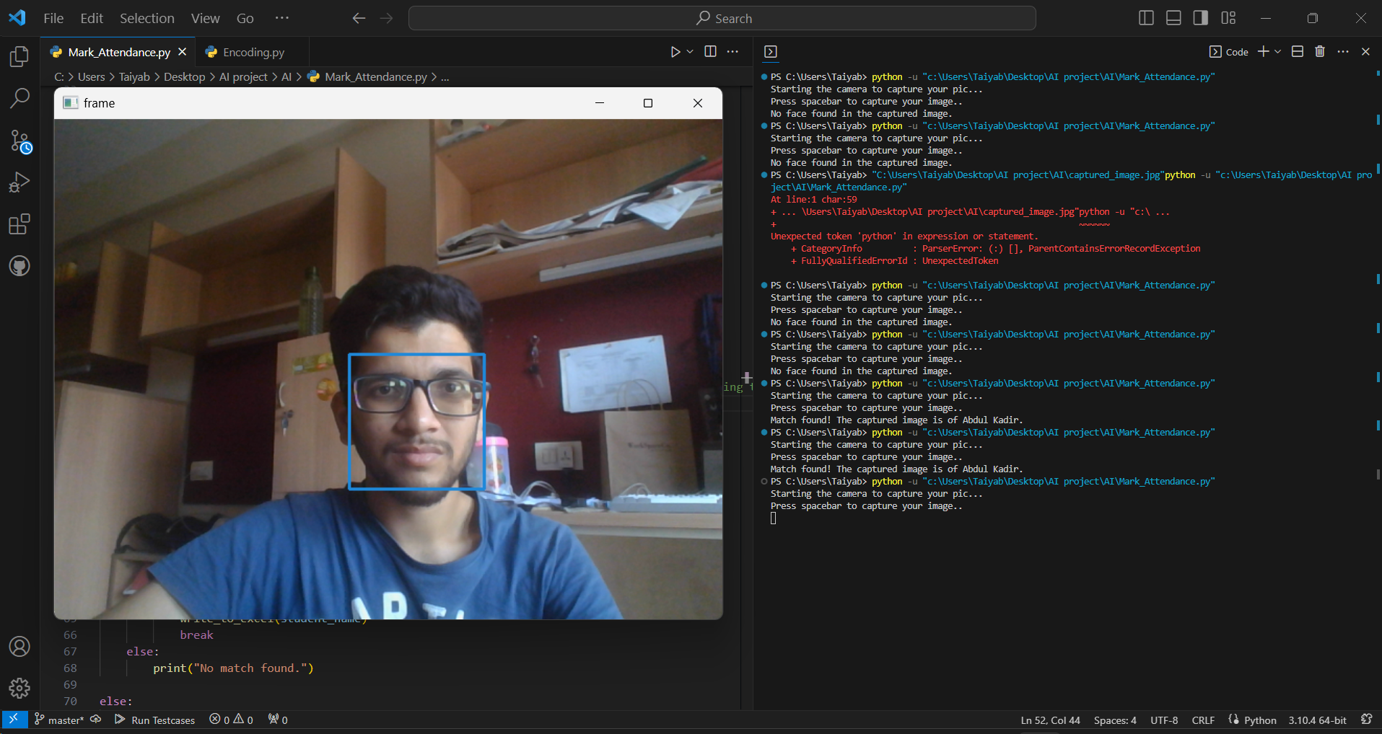
EXAMPLE
Here as you can see the model detects the face in the camera feed and draws a blue rectangle around it so as to distinguish between faces and other objects

Slide 9
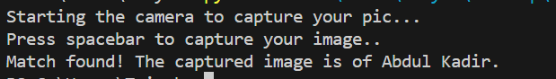
EXAMPLE
As the model identifies the person in the frame, a message is displayed on the terminal stating the name of the person.

Slide 10
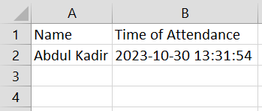
EXAMPLE
After identifying the person, the program saves the name and time into an excel sheet as shown above.

Slide 11



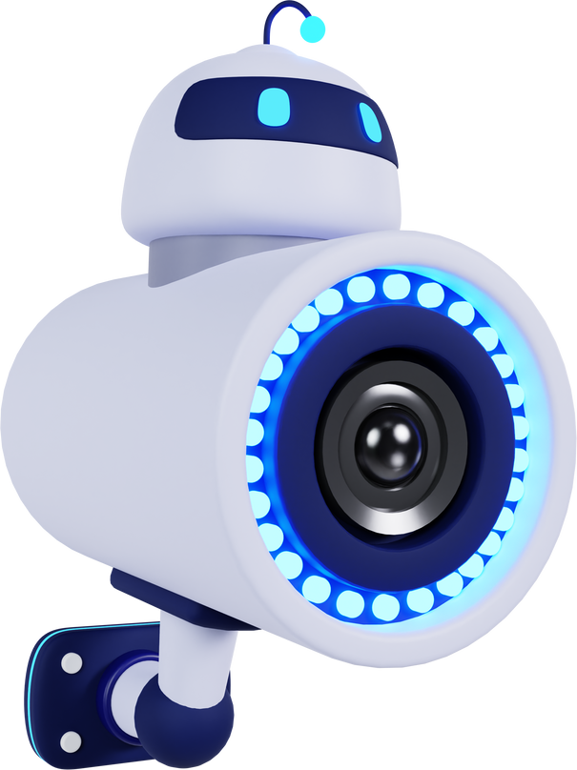

TEAM MEMBERS
Abdul Kadir Nalawala - ET21BTCO064
Ayush Kayasth - ET21BTCO049
Kirtan Kothwala - ET21BTCO053
Kirtan Khare - ET21BTCO050
Radha Gohil - ET22BTCO806
Today you will learn all about technologies and innovations in the modern world.
ok

Slide 12
Thank
You

